Slide 1
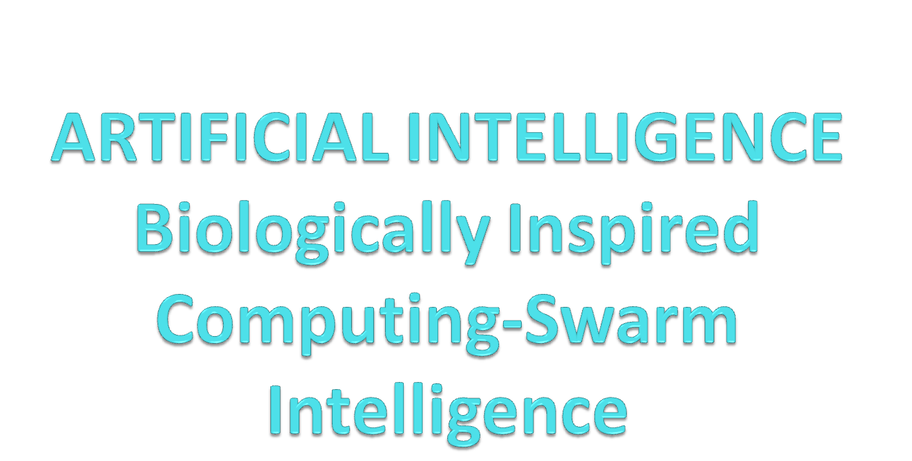
Presented by
K.Preethi
SP.Rathna Janani

Slide 2
What is AI?
Artificial Intelligence is a branch of Science which deals with helping machines and finds solutions to complex problems in a more human-like fashion.
Artificial Intelligence can help us understand this process by recreating it, then potentially enabling us to enhance it beyond our current capabilities

Slide 3
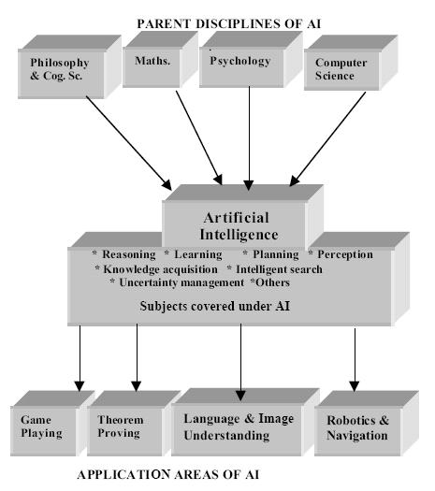
Parental Disciplines of AI

Slide 4
Biologically Inspired Computing
A field of study that loosely knits together subfields related to the topics of connectionism, social behavior and emergence.
The use of biology or biological processes in developing new computing technologies and new areas of computer science; and conversely, the use of information science concepts and tools to explore biology from a different theoretical perspective.

Slide 5
Swarm Intelligence
Swarm intelligence (SI) is artificial intelligence based on the collective behavior of decentralized, self-organized systems.
Swarm intelligence is the emergent collective intelligence of groups of simple autonomous agents.

Slide 6
Techniques
Ant Colony Optimization
Particle Swarm Optimization
Stochastic Diffusion Search

Slide 7
POS
PSO Algorithm
Initialization
Population loop
Goodness evaluation and update
Neighborhood evaluation
Determine vi
Particle update
Cycle

Slide 8
Future Scope
Swarm techniques for controlling unmanned vehicles.
The possibility of using swarm intelligence to control nanobots within the body for the purpose of killing cancer tumors.
In future the velocity of each individual must be updated by taking the best element found in all iterations rather than that of the current iteration only

Slide 9
Conclusion
Biologically inspired computing could allow the creation of new machines with promising characteristics such as fault-tolerance, self-replication or cloning, reproduction, evolution, adaptation and learning, and growth.
Bio computing has the potential to be a very powerful tool.

Slide 10
Thank You
QUERIES???

